Slide 1

PADDIFY
HACK4SHE
By TEAM REACTIFY

Slide 2
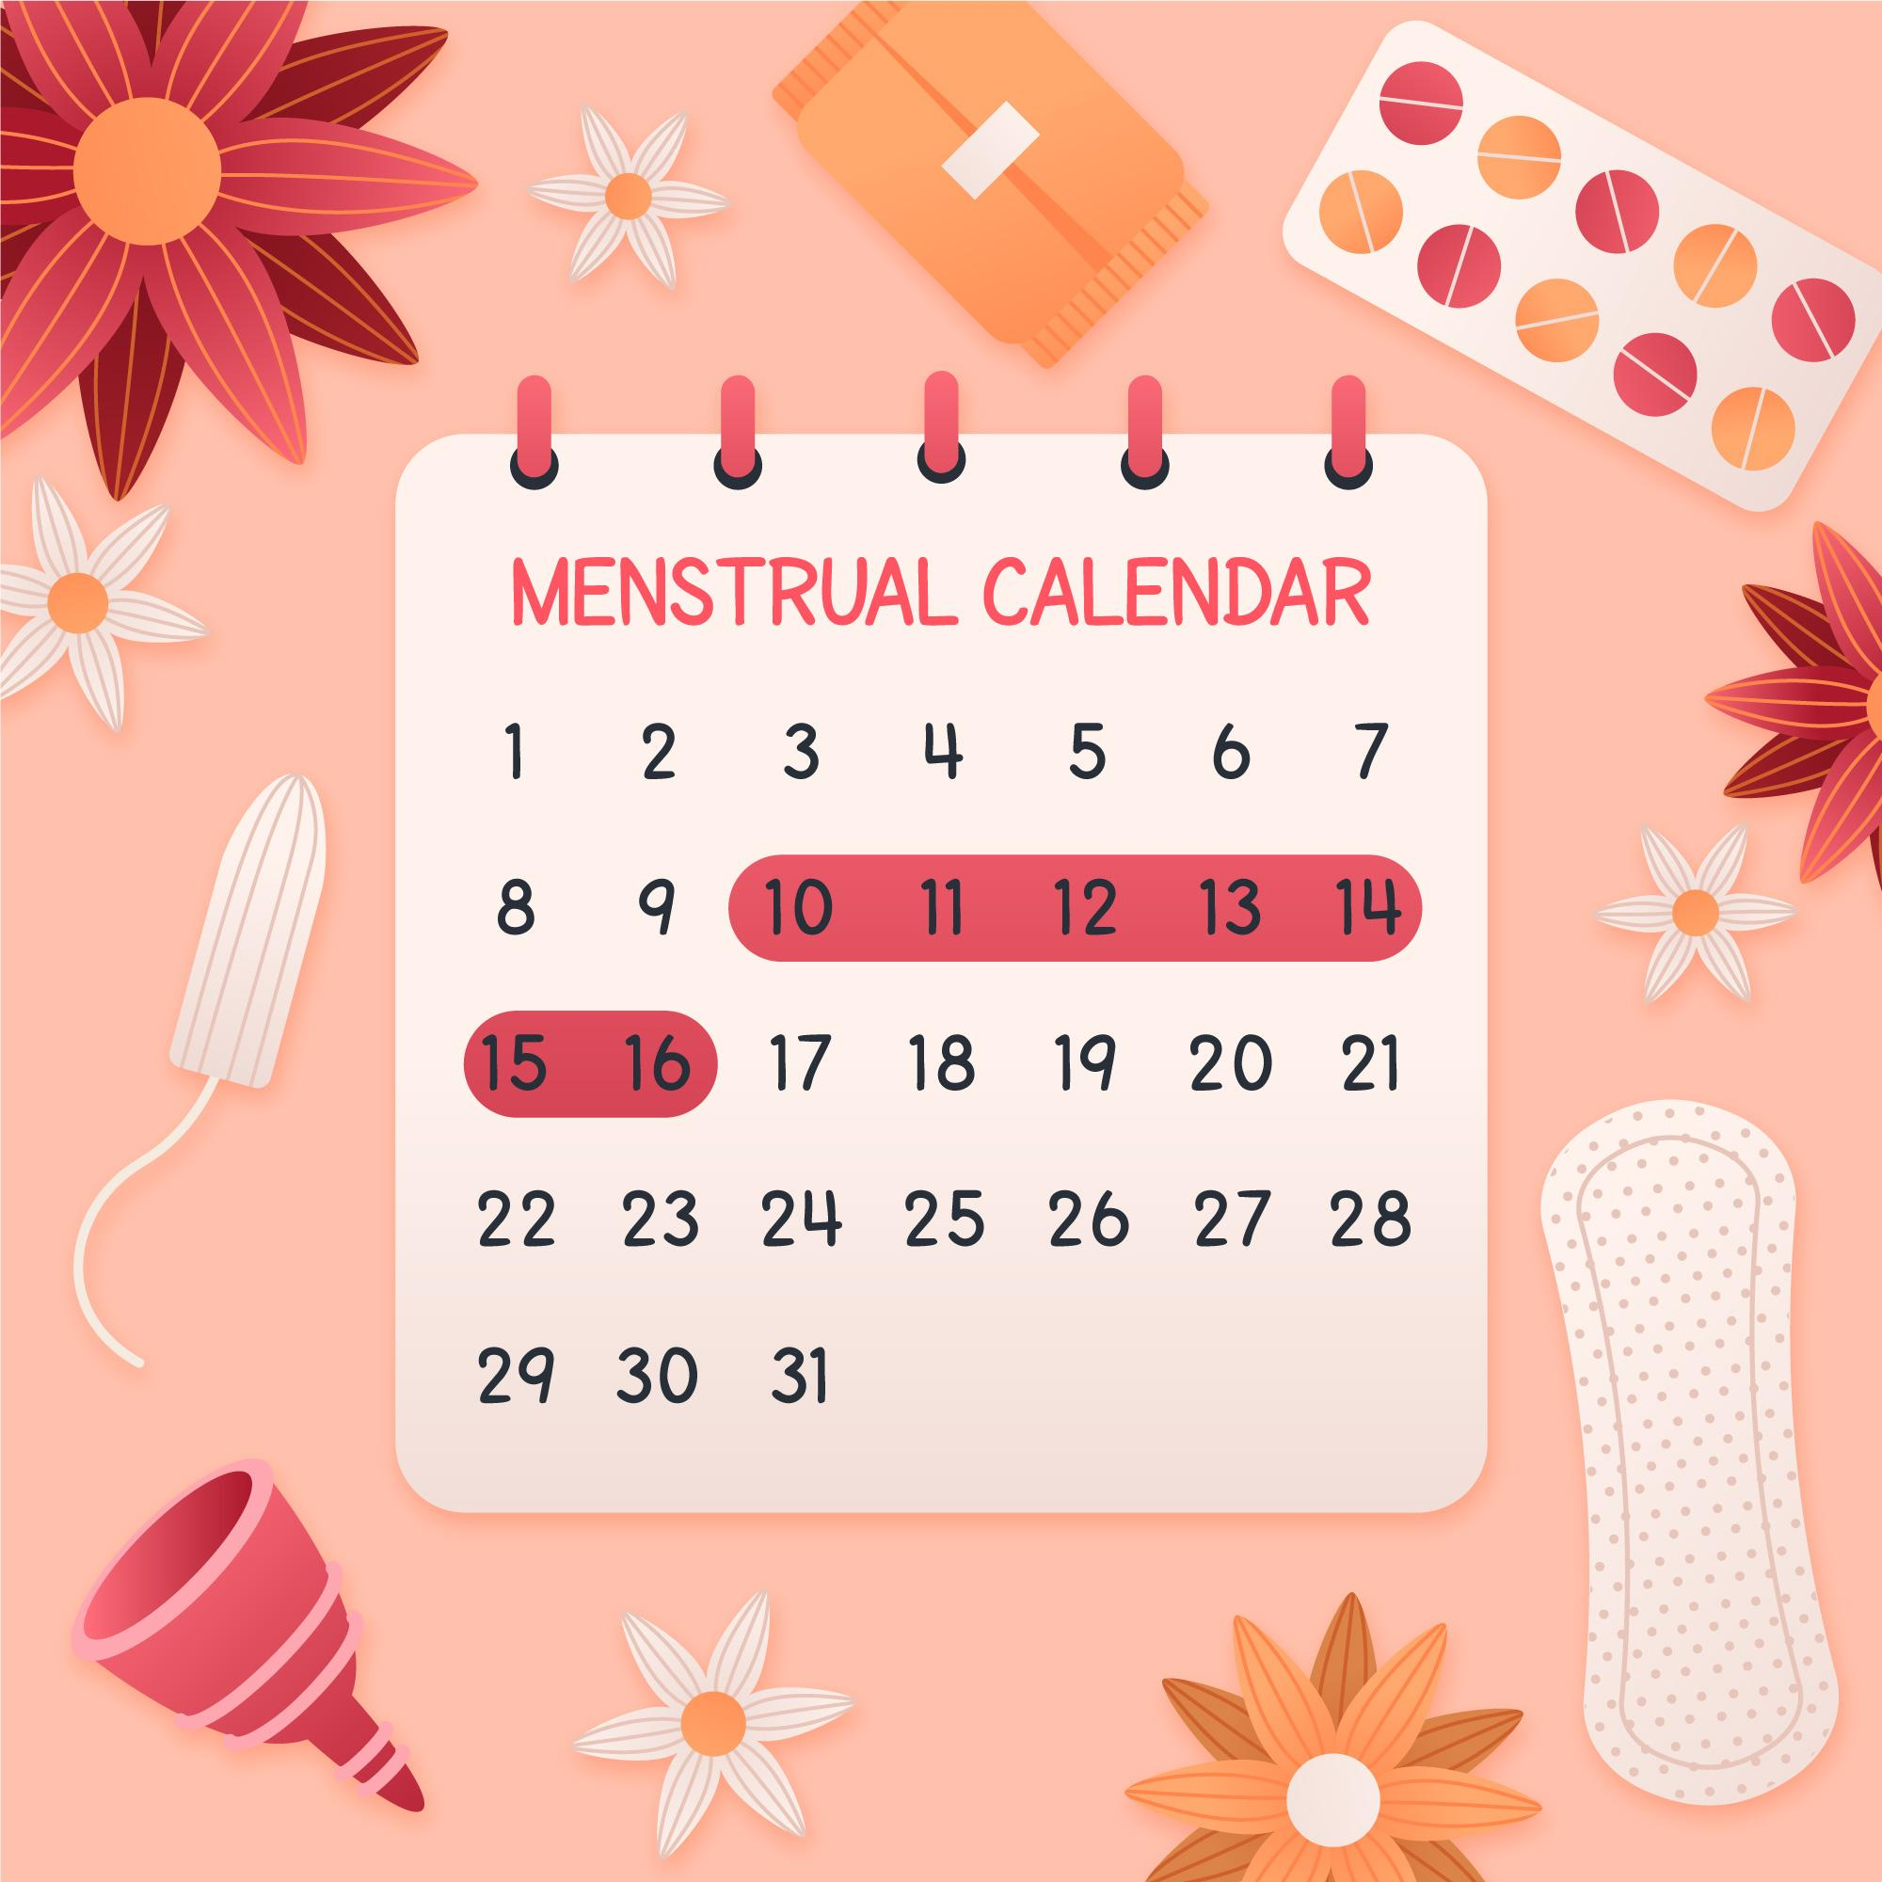
PROBLEM STATEMENT
Often girls in rural areas are having issues regarding sanitary pads. Also quality pads are costly. Arranging pads for them in the large amount is itself a heavy task for families with low income. As a result a large amount of girls and women suffer from various genital diseases.
Also lack of proper awareness and facilities hamper their
Education and psychological health.

Slide 3

Case study
Nearly 23 million girls drop out of school annually due to lack of proper menstrual hygiene management facilities, which include availability of sanitary napkins and logical awareness of menstruation.
Only 36 Percent Women Use Sanitary Pads In India. National Family Health Survey 2015-2016 estimates that of the 336 million menstruating women in India about 121 million (roughly 36 percent) women are using sanitary napkins, locally or commercially produced.
The study observed that 176 (64%) in urban area and 120 (45.11%) in rural area used sanitary pads and 99 (36%) girls in the urban and 146 (54.89%) girls in the rural area were using homemade sanitary pads.

Slide 4

SOLUTION
Paddify is a all-in-one platform(as of now static) for NGOs to raise fund and buy the sanitary pads for rural girls in huge amount.
Also, we connect sanitary pads manufacturing companies with NGOs or other organizations to buy pads in bulk in less amount, so that girls could be easily provided with pads.
This will also increase the awareness among girls in rural areas as still most of them are not familiar with sanitary napkins or menstrual cups.
Also it will be an easy-go platform for those who are willing to donate for a social cause.
Also we provide automatic assistance that can help the users understand us better
Technologies: React, Firebase

Slide 5
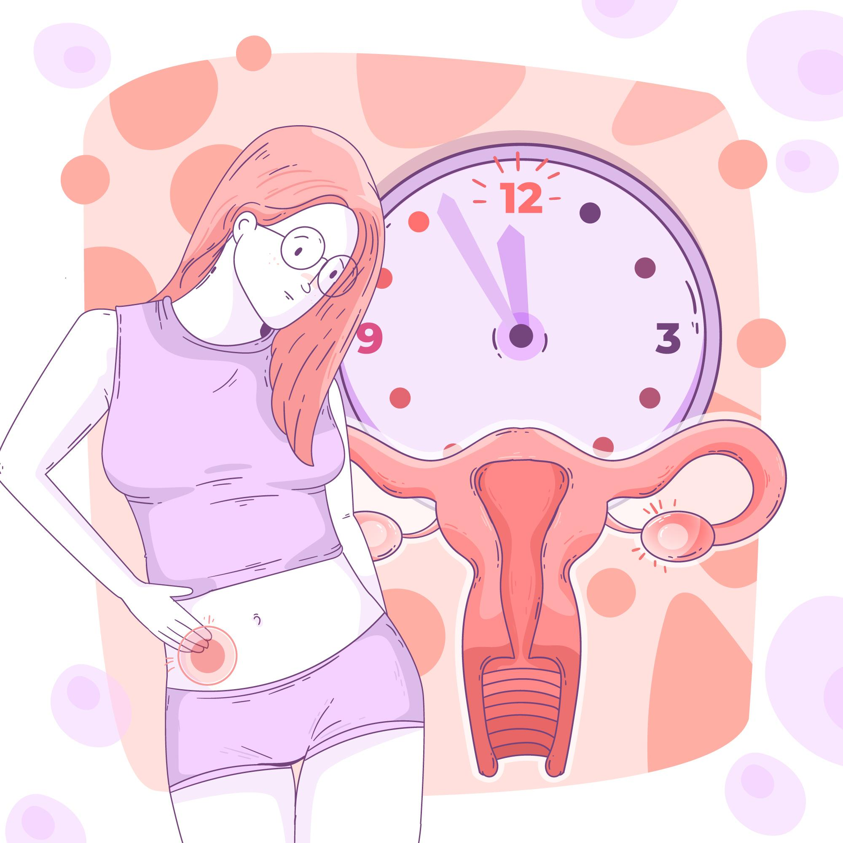
MARKET SIZE ANALYSIS
Total population of India = 1.38 Billion
Urban 30%
Rural 70%
Considering only rural part
Rural sex ratio – FEMALE : MALE = 950 : 1000
Total Female in rural = (950/1950) * 0.7 * 1.38 =0.47 billion
AGE GROUP
0 - 14 = 26.62%
14 – 64 = 67%
65+ = 6.38%
Menstruation starting age = 12 years
Menopause age = 50 years
Total 12 – 50 years = 5.7% + 49.58%
= 55.28%
Total Female in rural from 12 – 50 years =0.5528*0.47 billion =0.26 billion

Slide 6

NGO’S AVAILABLE for women health
There are about 3.2 million NGOs in India out of which
0.48 million NGOs are working for women Healthcare.
LIST OF FEW ARE :
CODE RED.
A PERIOD OF SHARING.
GREEN THE RED.
SHOMOTA.
ECOFEMME.
UGER.
#HAPPYTOBLEED.
THE RED CYCLE.
HAIKU.

Slide 7



User persona
This is Ruchi. She is 12 years old and have recently hit her puberty.
She loves going school but on her periods she feels uncomfortable to walk experiences itchiness , So she can not go to school
This is Harpreet and she is in her mid 20’s. She has been managing her periods with rough clothes. She is not aware of pads and has suffer a lot on are cycle days
She is Akansha. She is 45 years old and married. She suffered from genital infection and still uses clothes to control her flow.

Slide 8

USER JOURNEY
There will be three types –
Donor, NGO, Pad producing Companies.
Donor:
It is a simple interface where individual or team willing to donate can signup with Paddify.
Then they need to look among the list of NGOs registered with us.
They can choose the Ngo they are willing to donate in and Click on the donate button.
They need to fill the amount they want to donate and along with the required details.
The amount will be transferred to NGO’s bank account.
And the amount donated will be visible in the user profile which will help them to keep track of the transactions.

Slide 9
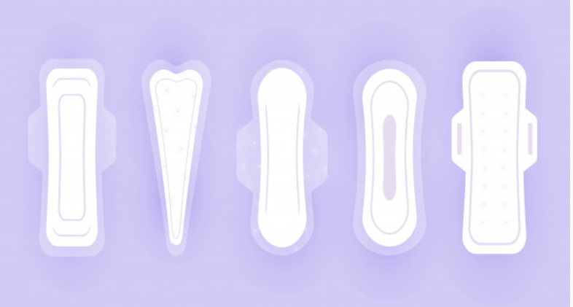
USER JOURNEY
PAD-PRODUCING COMPANY
The companies can connect with Paddify.
Here they can get a lot of bulk orders from the NGOs who are working for women healthcare.
They will have a permanent and assured customer if they get connected with paddify.
NGO:
It is a simple interface where NGOs can signup with Paddify.
Once they signup, they will be registered and there names will be reflected in the Paddify website.
They need to provide their bank details and the cause they are working for so that users can donate.
The NGOs can connect with the pad producing companies and place pad orders at a bulk rate and heavy discounts.

Slide 10

FUTURE SCOPE
The NGOs can directly get registered on the website and start raising fund.
Payment Gateways
We will be making a machine learning model to predict the periods and keep track of it.
We will also be providing tests that will ask them a few questions and then determine whether she is suffering from any menstruation disease.
We will also connect them with doctor online so that
they can get consulted for free and avail
treatment.
Also we are planning to add the “request pads for social cause” feature soon.

Slide 11

GO-TO MARKET STRATEGY
FUNDRAISING CAMPAIGNS
SOCIAL MEDIA MARKETING
MEMBERSHIP MUTUAL BENEFITS
SOCIAL RECOGNITION STRATEGY.

Slide 12

COMPETITOR ANALYSIS
In Indian market although there a lot of fundraising website but till now no one is able to connect all the 3 types of users together like PADDIFY.
Unlike other website , it allows NGOs to get registered and showcase their needs. Also in future they can directly request for pads.
It keeps complete transparency and the Donars are recognized for their social works.
Every Donars and NGO can keep track of the transactions happening in Paddify.
We at Paddify are more focused on building a community that can help the women’s in need.

Slide 13
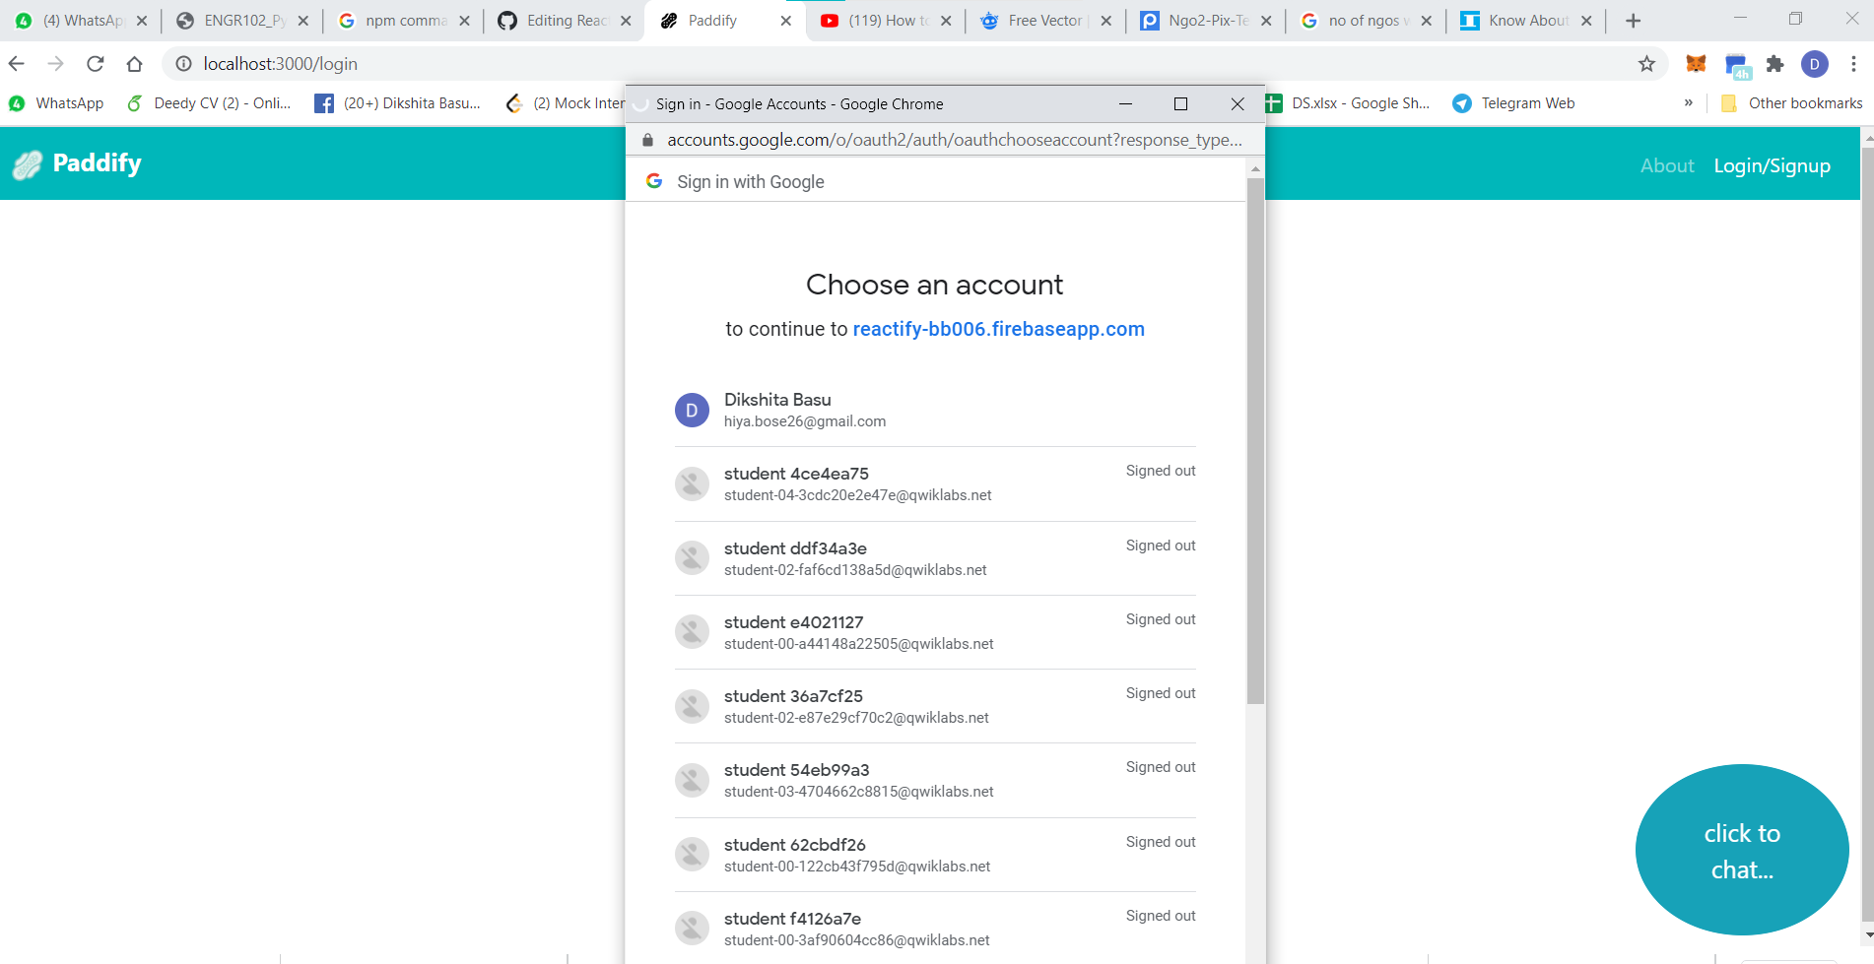
USER-JOURNEY (PICTORIAL)

Slide 14
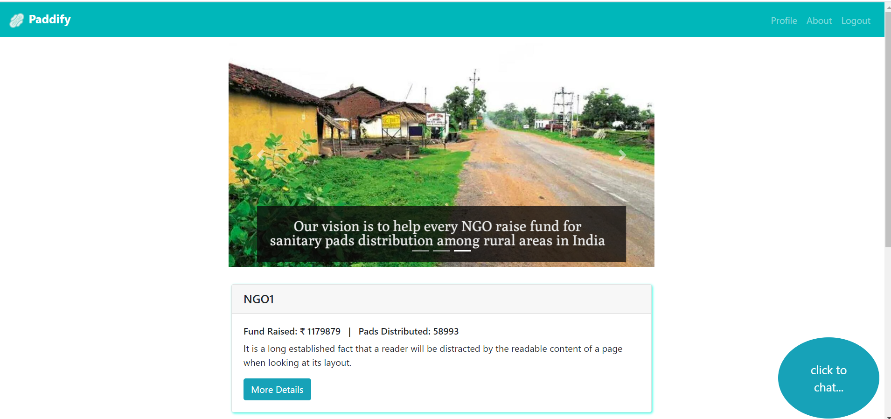

Slide 15
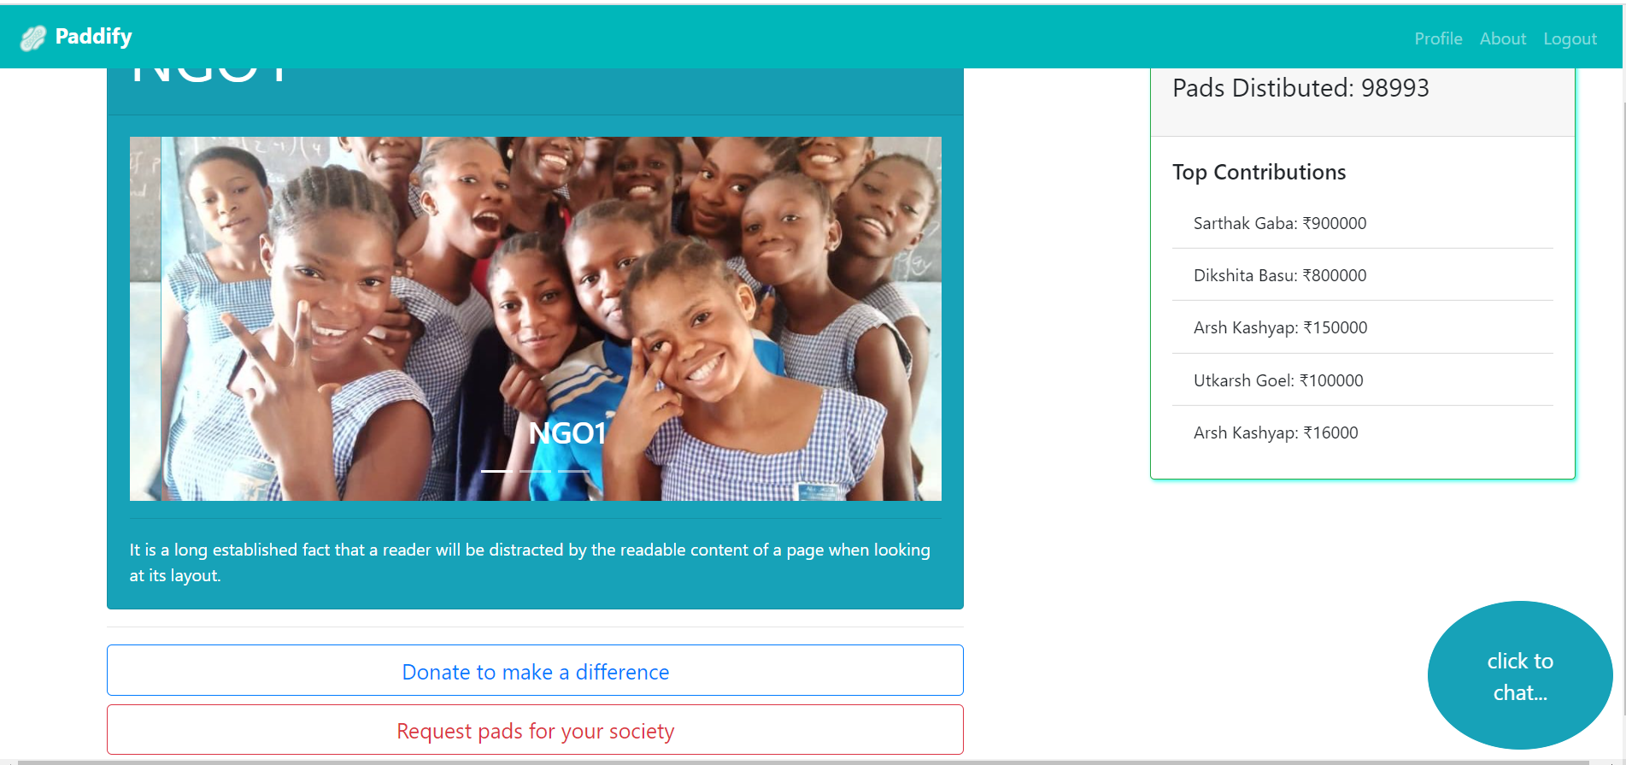

Slide 16
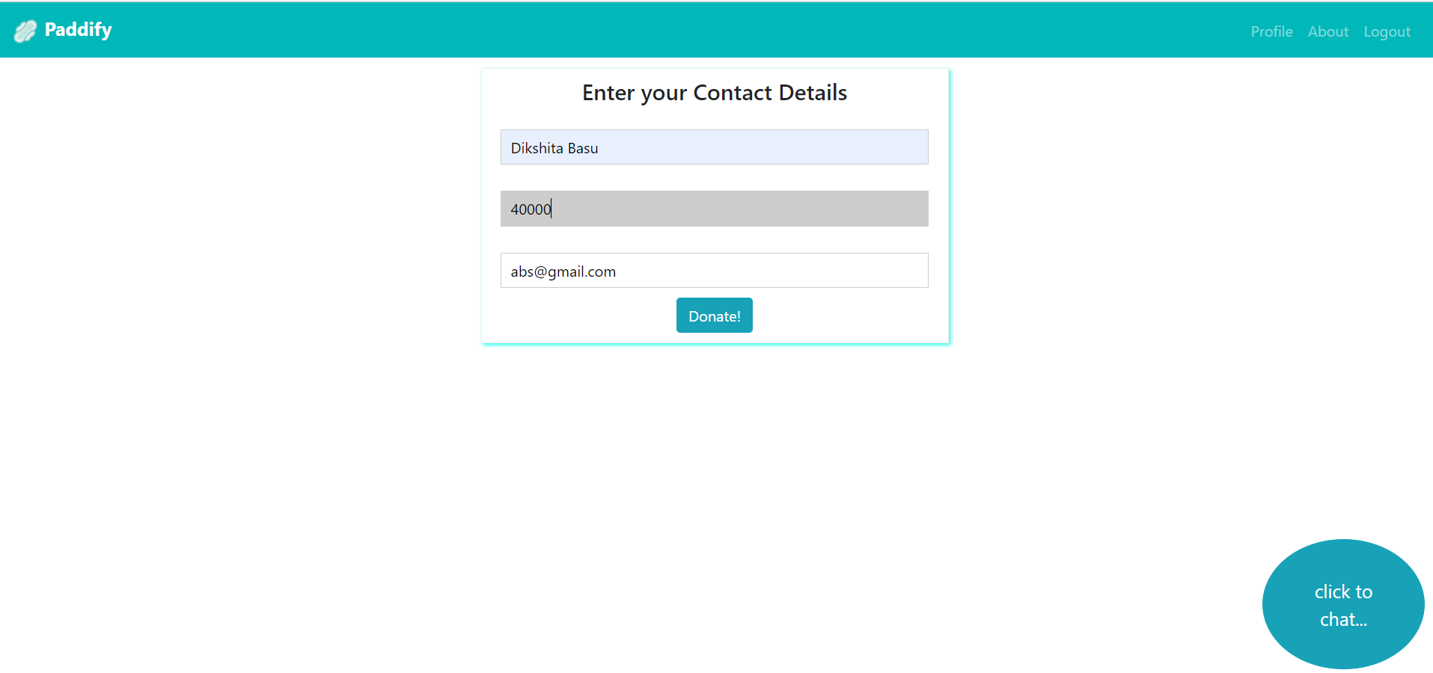

Slide 17
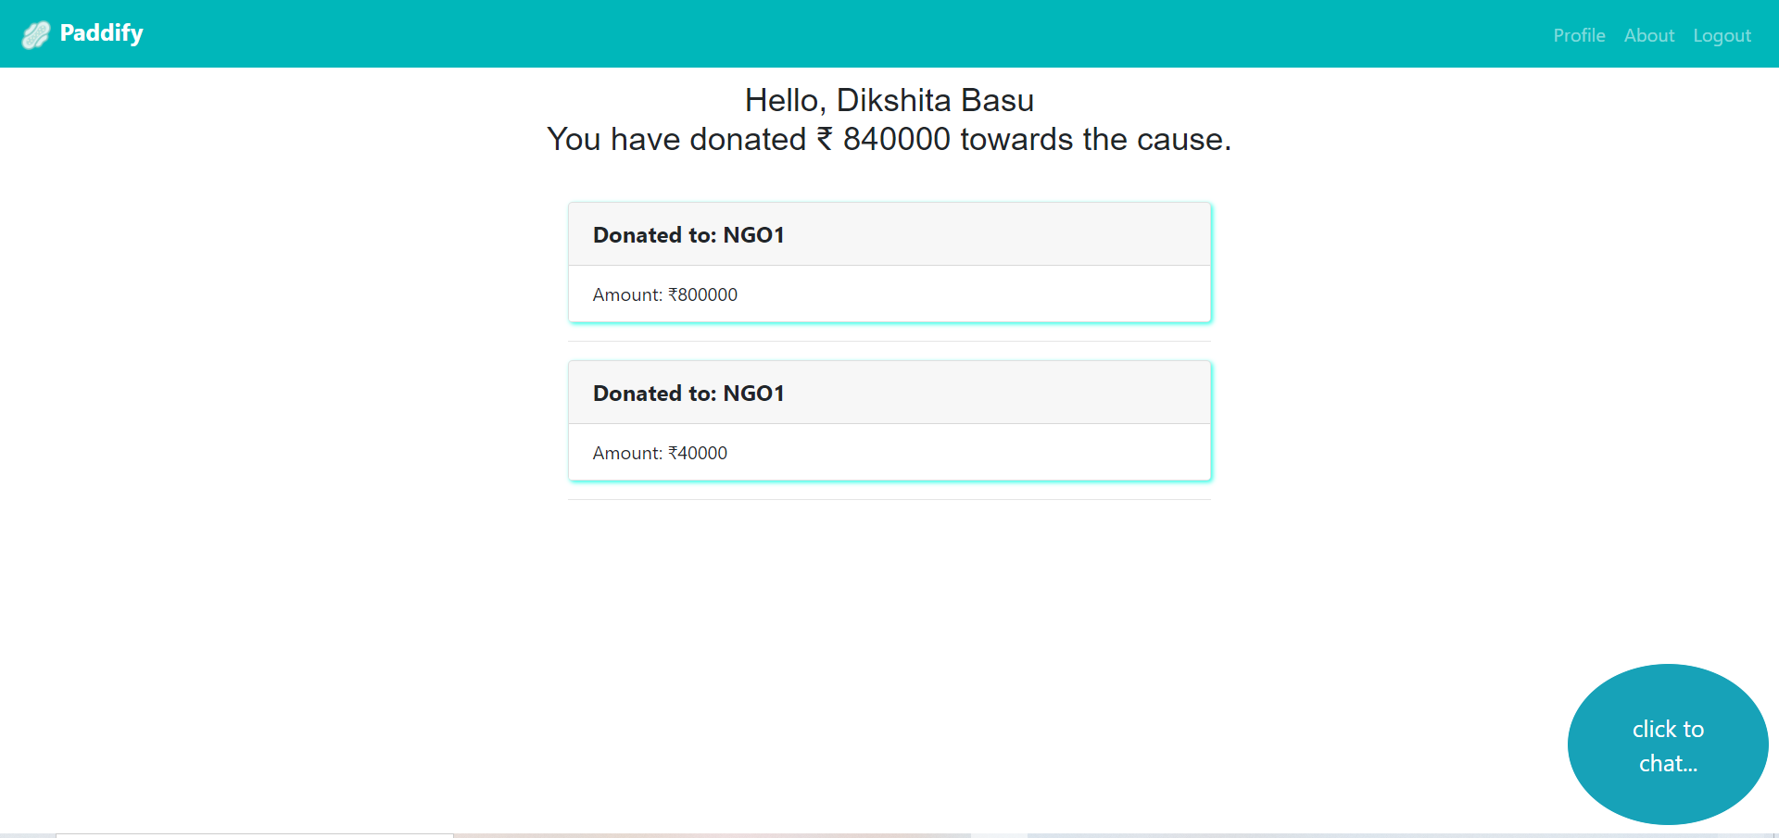

Slide 18
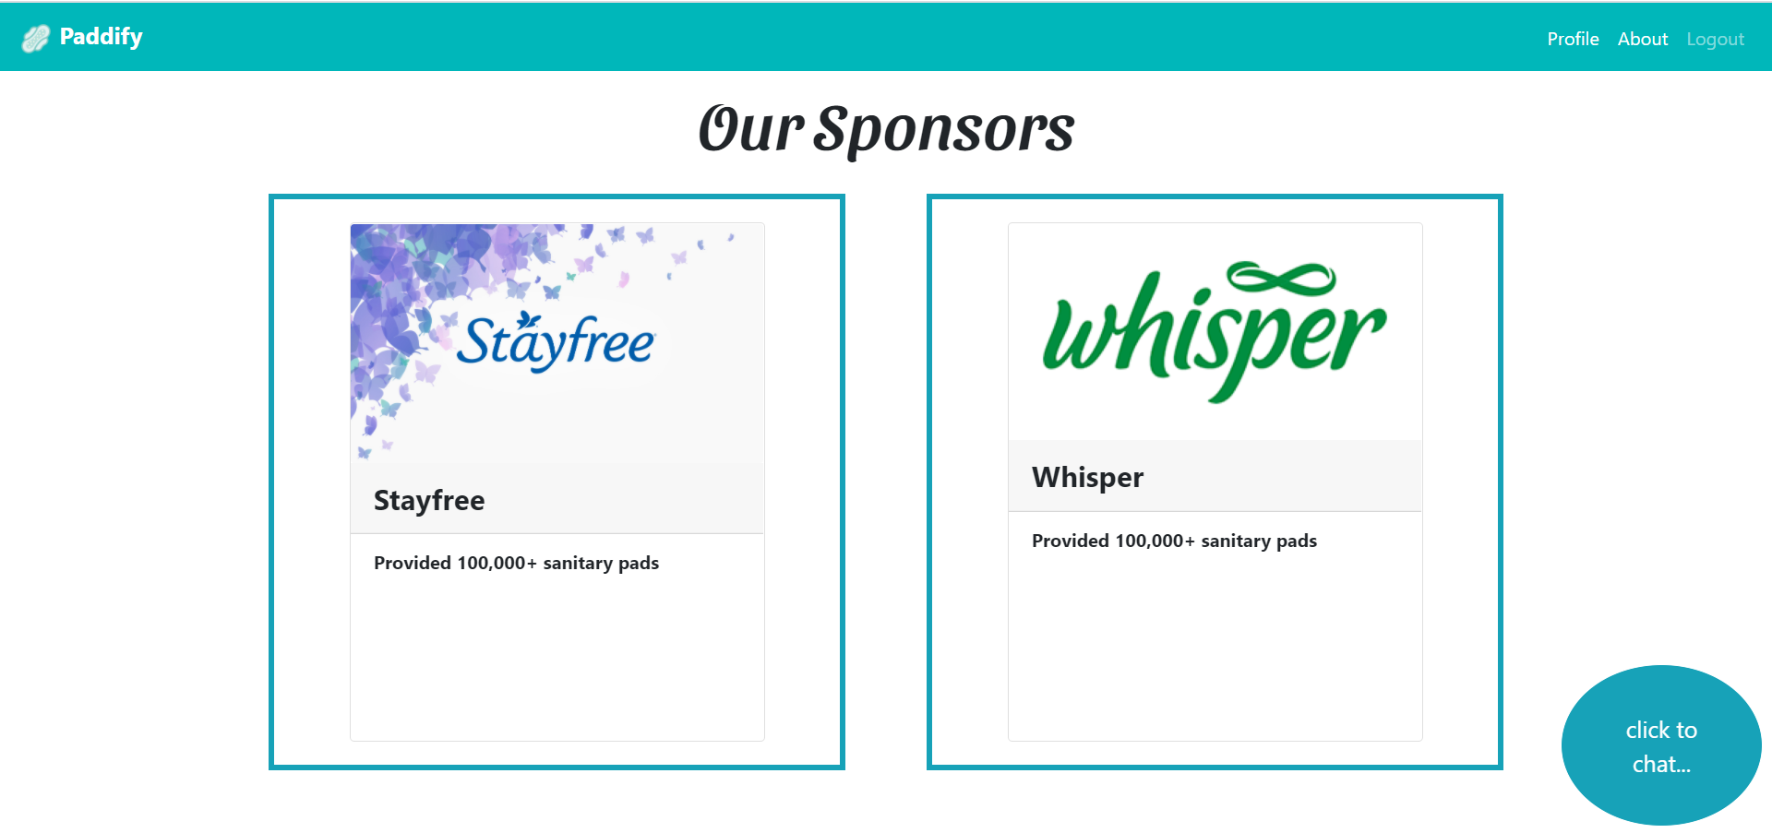

Slide 19
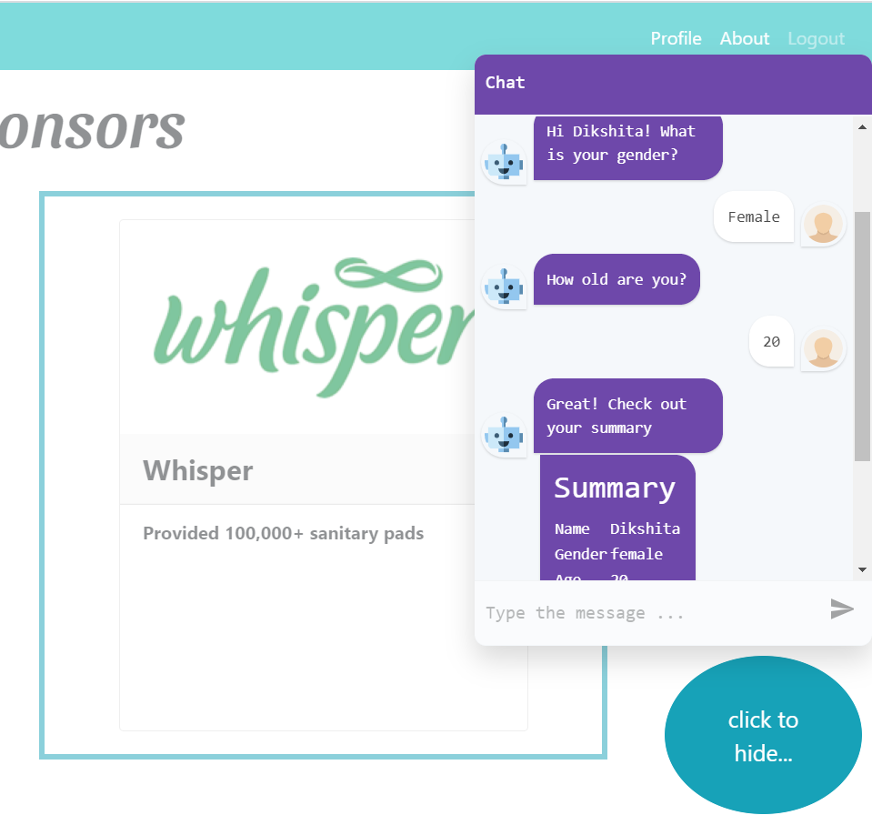
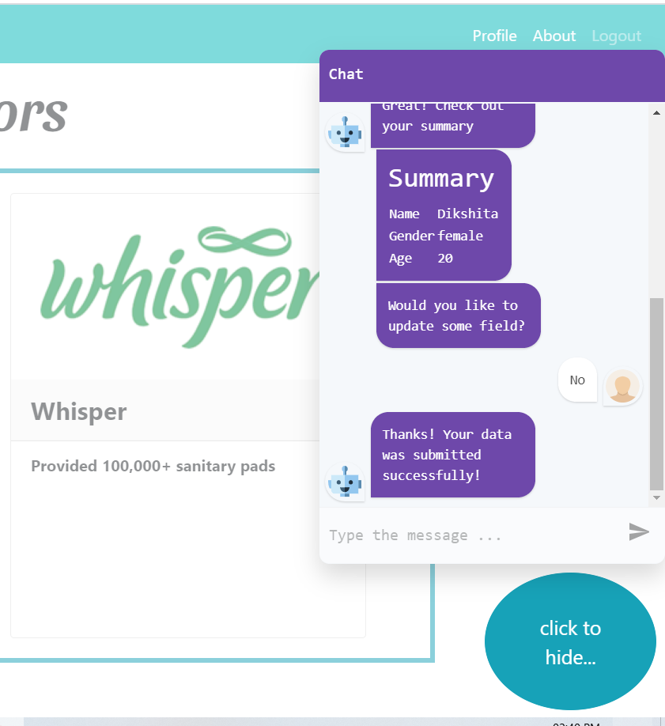

Slide 20


